Slide 1
CW2 - Common Mistakes
and Feedback

Slide 2
Task 1 - BSc
Task 1 was generally very well answered, well done!
Here we provide a few clarifications on some common mistake or missed analysis
First, remember to comment on aspects that are specifically required e.g.:
- whether the early stopping was triggered and at what epoch (depending on the random seed, one could have that early stopping was triggered or not)
- why the dimensions of the low-dimensional representation of a sample was [8, 5, 5]
(computable using the output dimensions of the different layers, see PyTorch documentation https://pytorch.org/docs/stable/generated/torch.nn.Conv2d.html)

Slide 3
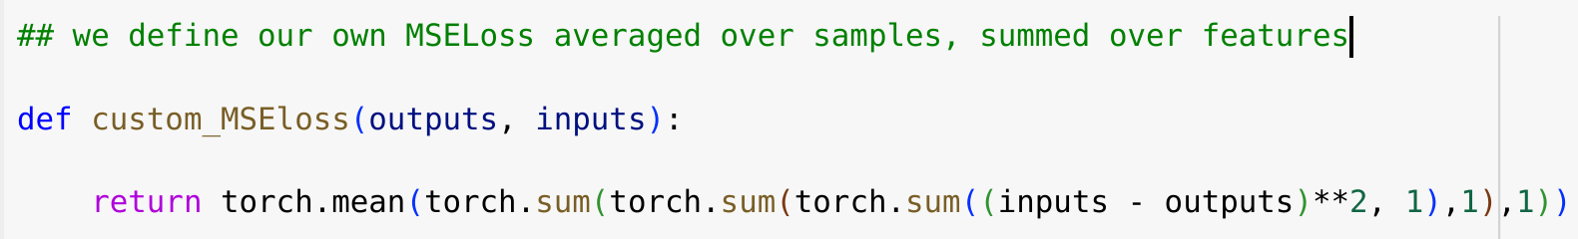
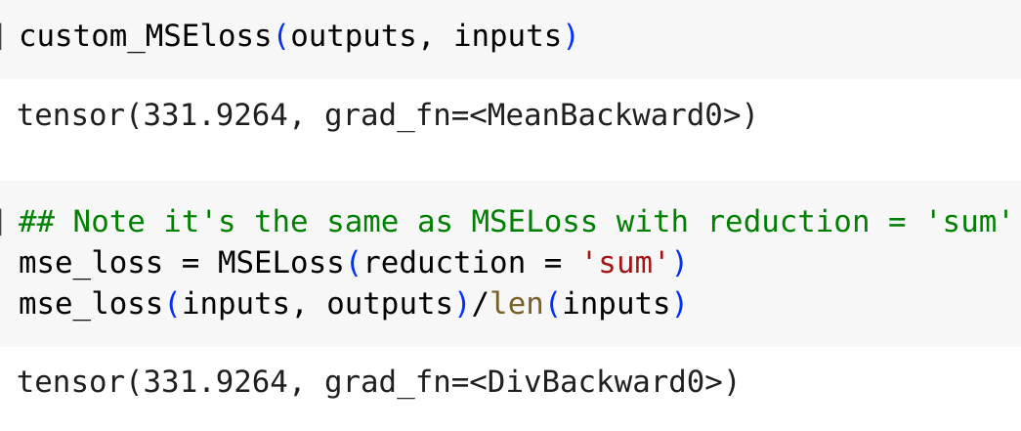
Task 1.1
The default MSELoss() in Torch did not give exactly the MSE we asked for, because it averages both over features and samples, while our MSE is averaged over samples only (it was clearly still good as training objective function!)
One could have defined a custom MSE function:
Or used the option reduction = ‘sum’

Slide 4
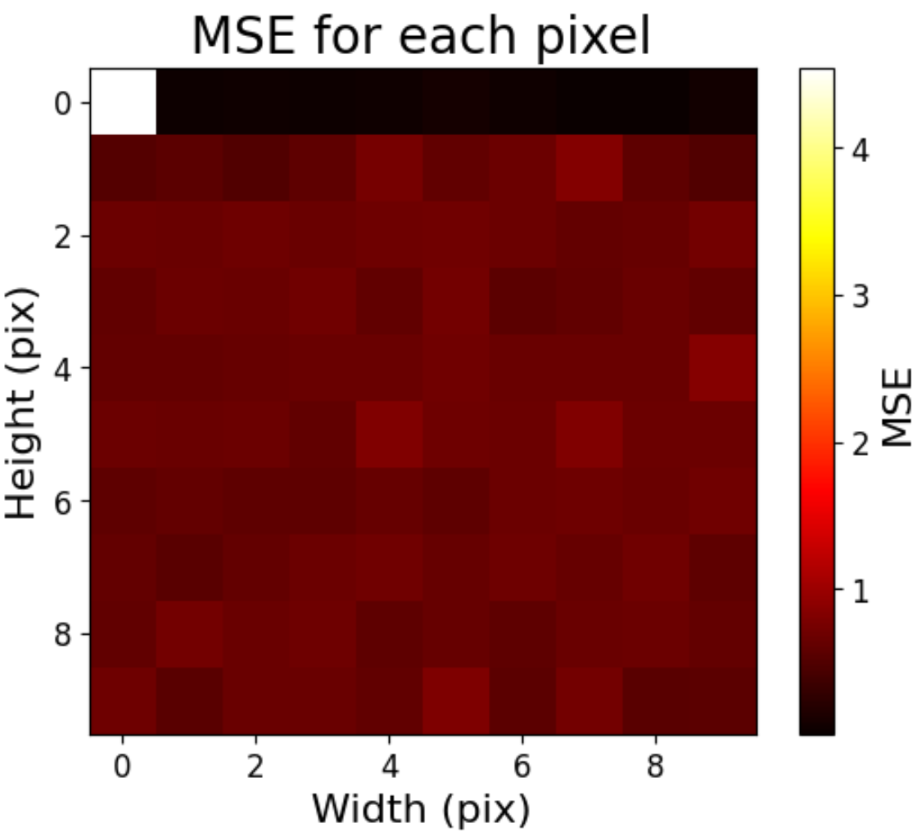
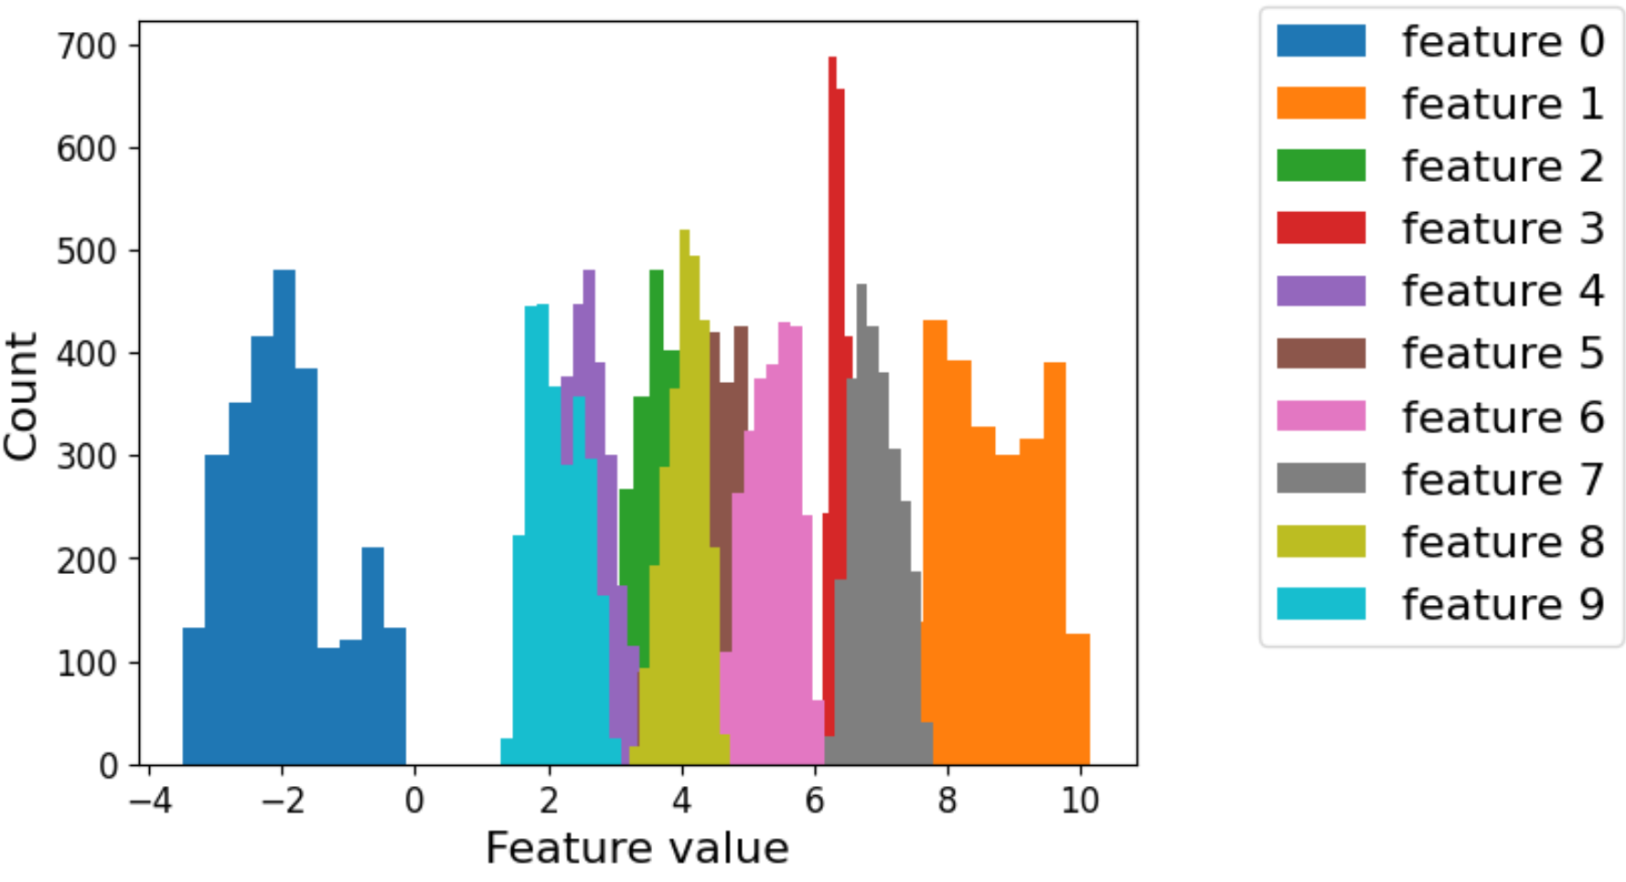
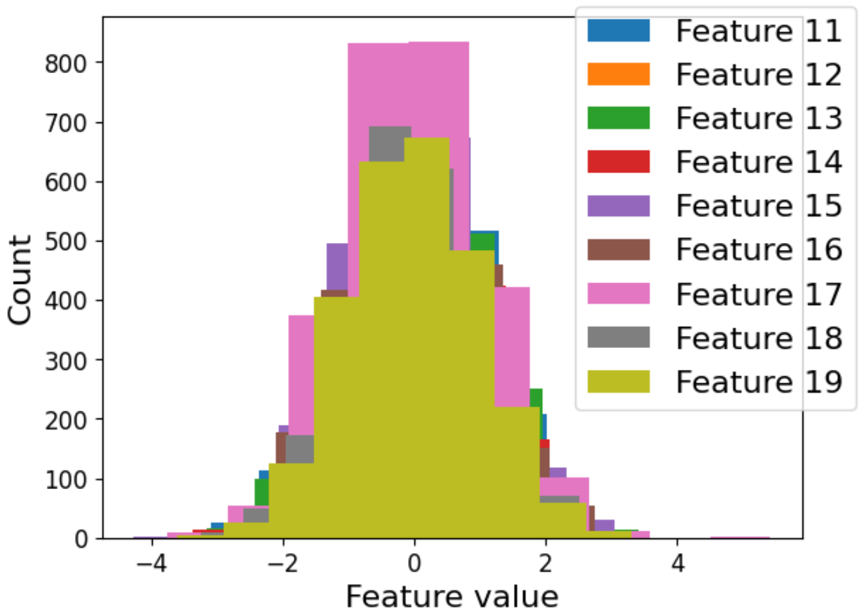
Task 1.1: per-feature MSE pattern
Negative thus not well reproduced
Positive thus well reproduced
was crucially determined by the final ReLU,
which sets to zero the negative values!
Many students did not flag up this connection.
Feedback given:: -1 did not explain the reasons for the MSE values for the first 10 features (i.e., due to their sign and the effect of final ReLU)
Features 11-100 centred at zero: uniform, intermediate reconstruction quality

Slide 5

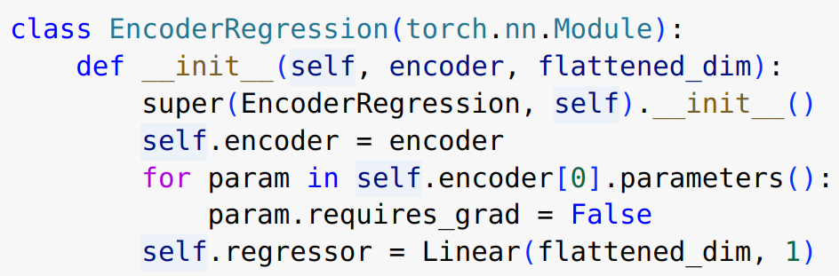
Task 1.2
From 1.1
The encoder should have been taken from the autoencoder of 1.1
It should have NOT been re-initialised, or retrained differently!
The encoder should have been kept frozen during training: like in this way
Or, alternatively, you could have given the encoder’s output as input to the regressor

Slide 6
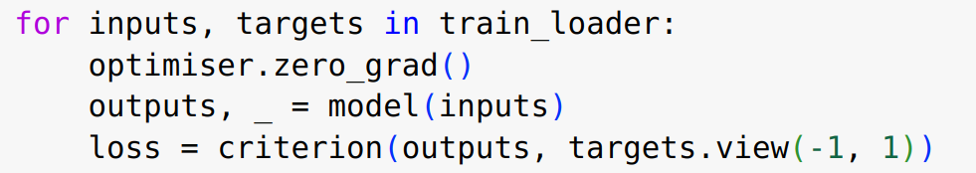
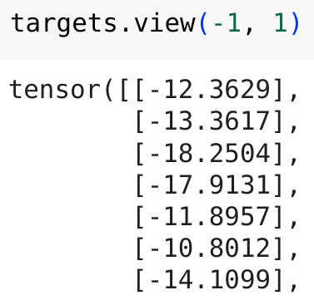
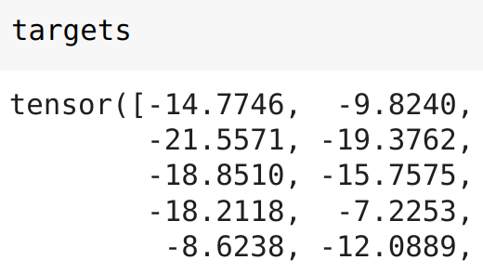
Task 1.2
For the MSE of regression, it was important to check the arguments’ shape
See here for example
Different from:

Slide 7
Task 1 - MSc
Task 1 was generally very well answered, well done!
Here we provide a few clarifications on some common mistake or missed analysis

Slide 8
Task 1.1
The default MSELoss() in Torch did not give exactly the MSE we asked for, because it averages both over features and samples, while our MSE is averaged over samples only (it was clearly still good as training objective function!)
One could have defined a custom MSE function:
Or used the option reduction = ‘sum’

Slide 9
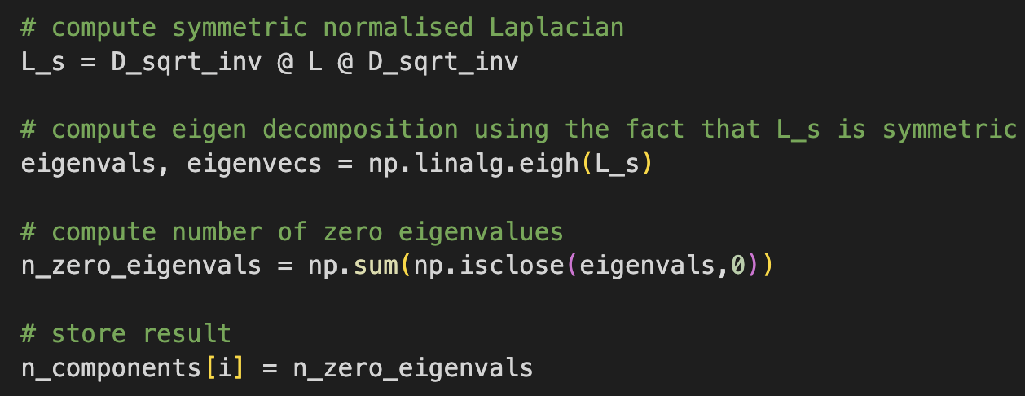
Task 2.1:
Task 2 was generally very well answered, well done!
One of the most common issues was that the implementation of n(delta) often used facts not known from the lecture, hence we expected additional justification. What knew from the lectures was that the number of components in a graph is given by the algebraic multiplicity of the 0 eigenvalue of the symmetric normalised Laplacian:

Slide 10
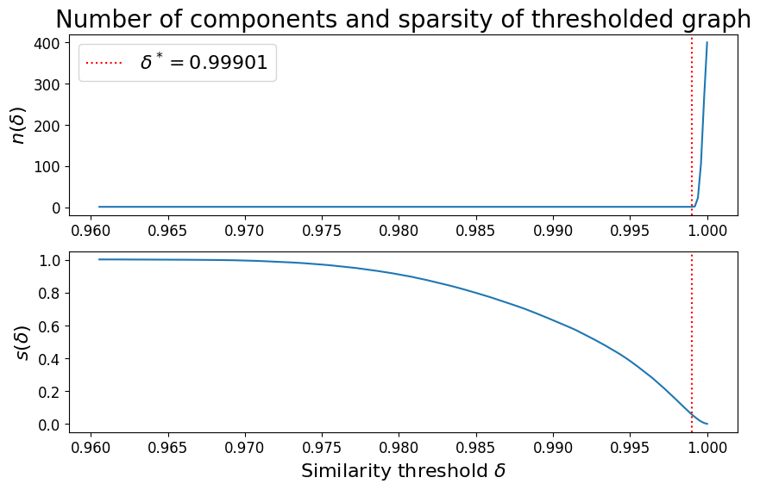
Task 2.1:
It was also important to evaluate n(delta) and s(delta) over the correct range of deltas, roughly from 0.9606 to 1, see example plots below:

Slide 11
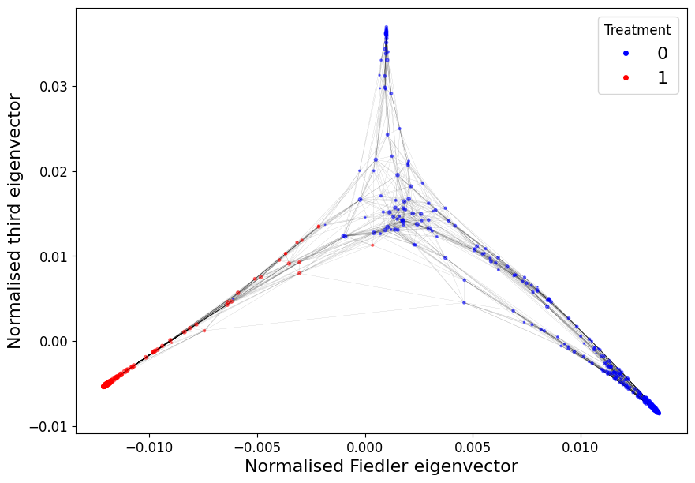
Task 2.1:
The discussion of the spectral layout was generally well done:
We expected to hear that nodes with treatment=1 are clearly separated from the other nodes and that they form a more densely connected subgraph.
As an explanation we expected to hear that the treatment induces more similar gene expression for the nodes with treatment=1, leading to higher cosine similarities and more edges between nodes with treatment=1.

Slide 12
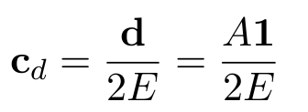
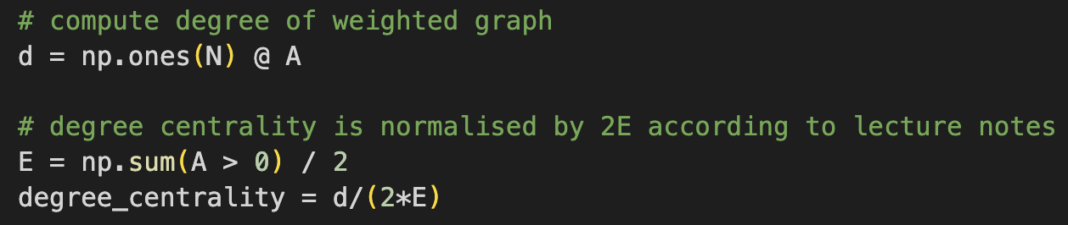

Task 2.2:
The degree centrality has to be normalised according to the formula given in the lecture notes.
Here E refers to the number of edges in the graph.
However, we also accepted when E was computed as
While we asked for the degree centralities to be plotted in a histogram, we asked to compute the mean degree for each group, not the mean degree centrality.

Slide 13
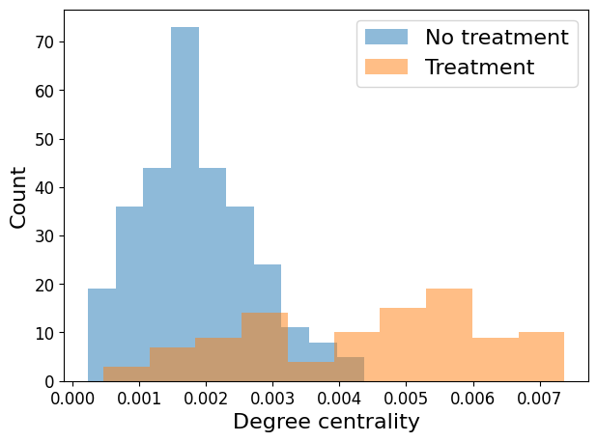
Task 2.2:
Again the discussions in 2.2 were generally really good.
As an explanation for the difference in degree centrality we expected to hear that nodes with treatment=1 have higher degree because treatment induces similar patterns of gene expression (leading again to higher cosine similarity).

Slide 14

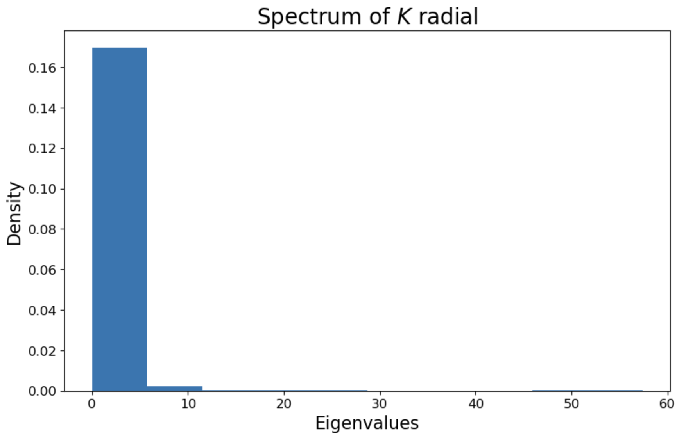
Task 3.1
The most common mistake here was in centering the kernel, which we do via equation 10.15 in the lecture notes:
Which is coded as:
Most students didn’t spot why the spectrum plot shows the kernel is valid; it should show that the eigenvalues are non-negative as required. You should still point out this even you got negative values from mistakes.
non-negative

Slide 15



Task 3.2
Here the most common mistakes occurred in completing the `pca_function_kernel` including:
A mistake in constructing the matrix to perform spectral decomposition (C), the kernel function should be used on the input data
Not correctly normalised the eigenvectors according to the following:
The projection being applied on X when it should be on C

Slide 16
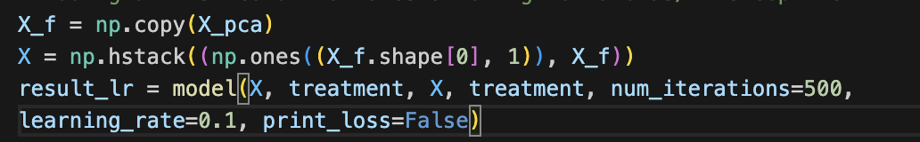
Task 4
Most students forgot to add an intercept column to the data in any of the logistic regression applications. You are also required to use the whole dataset but many still splitted into training and test sets.
Correct implementation:

Slide 17
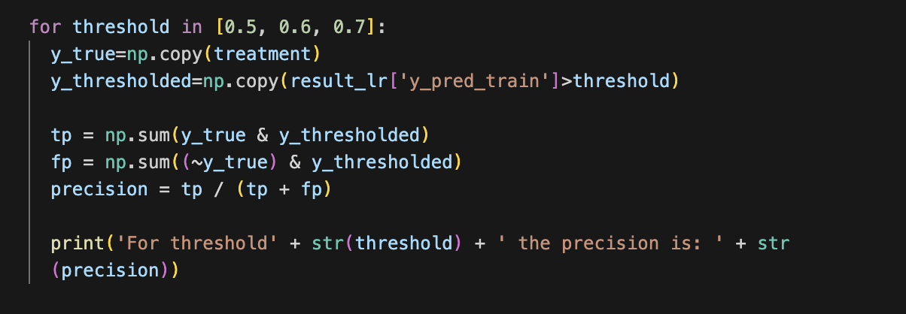
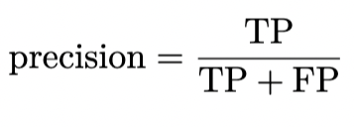
Task 4.3
In order to investigate different thresholding values, the results from logistic regression needed to be compared with the threshold value.
Very few students calculated the precision as asked, with most reporting the accuracy.

Slide 18
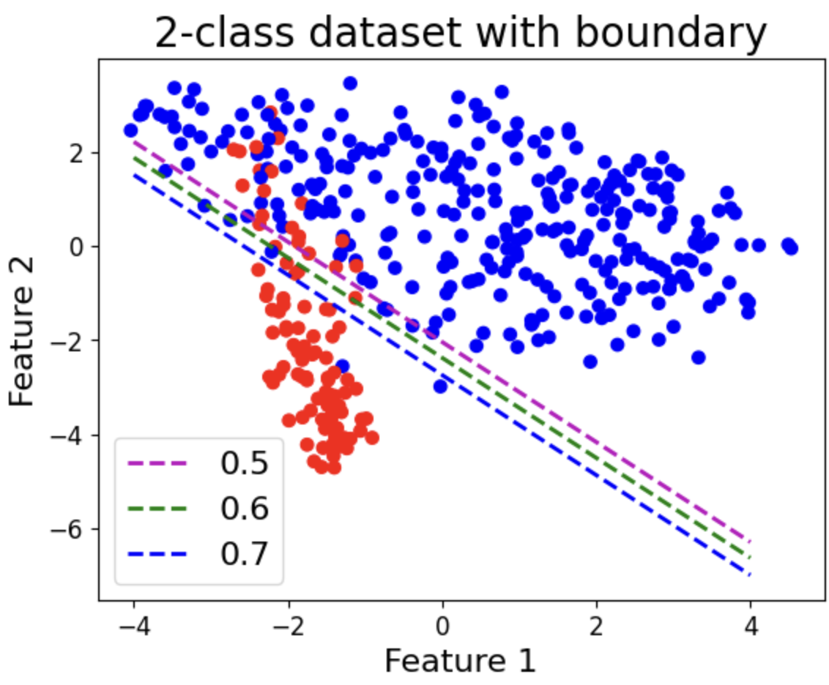
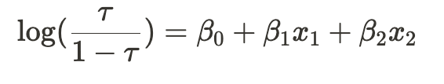
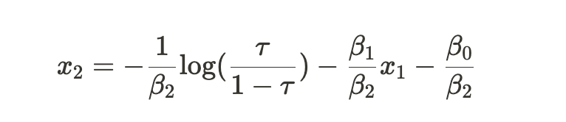
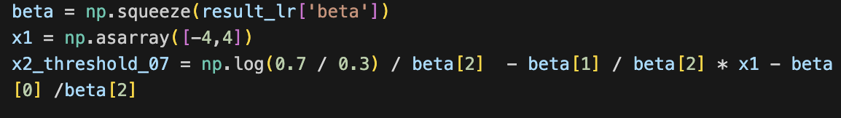
Task 4.3
In order to plot a decision boundaries on the scatter plots, you need to consider the logistic regression formulation:
Which can be rearranged to give:
Which for tau=0.7 is:

Slide 19
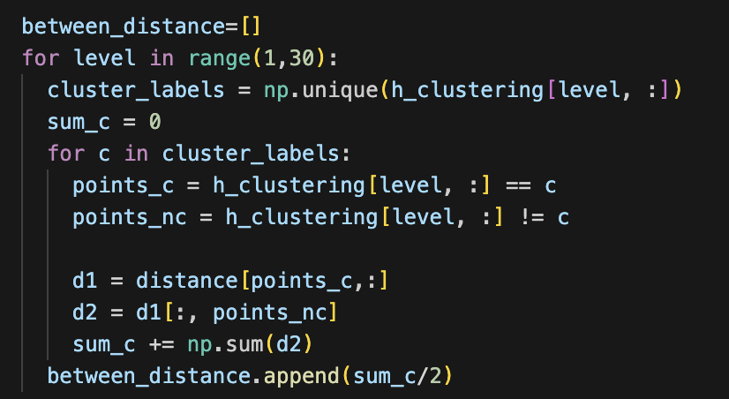
Task 5
Here the main challenge was extracting B(C) at each level.
To do this we had to:
correctly identified the unique set of labels at each level (it’s not {1,..., k})
extracted distances correctly

Slide 20
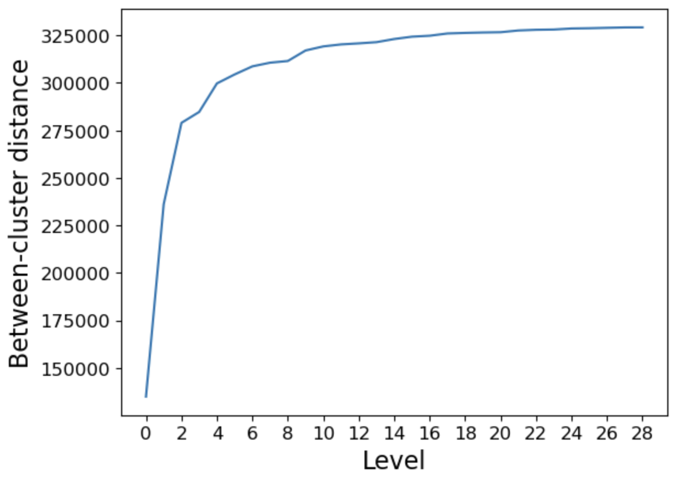
Task 5
Many students did not determine the optimal K, using the plot of B(C) and the elbow technique:
Lastly, many students incorrectly calculated the NVI not selecting a level and calculating:
As with the within-distance W(C) as a function of the number of clusters we looked at the elbow of a decreasing curve, here the idea is to take the elbow of an increasing curve, i.e., to take the number of clusters after no significant improvement in B(C) is observed.
Rather than:

